Slide 1
Duel Links Promotion Website Alvin Darmawan Salim 4SC5

Slide 2






TECHNOLOGY USED

Slide 3
WEB SUMMARY
The purpose to create this website is for promoting game. The game that used to be promoted is the traditional card game Yu-Gi-Oh! Duel Links!
Yu-Gi-Oh! Duel Links is a free-to-play, digital collectible card game developed by Konami for Microsoft Windows, iOS and Android devices, based on the trading card game of the same name.

Slide 4
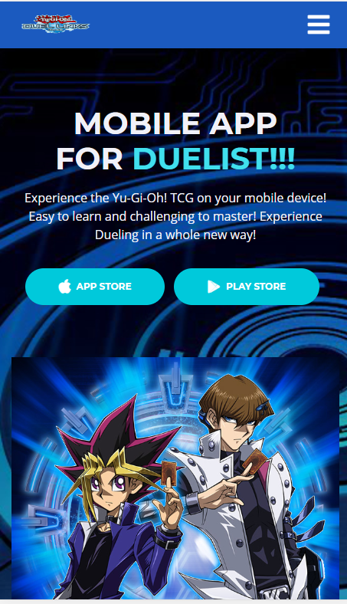
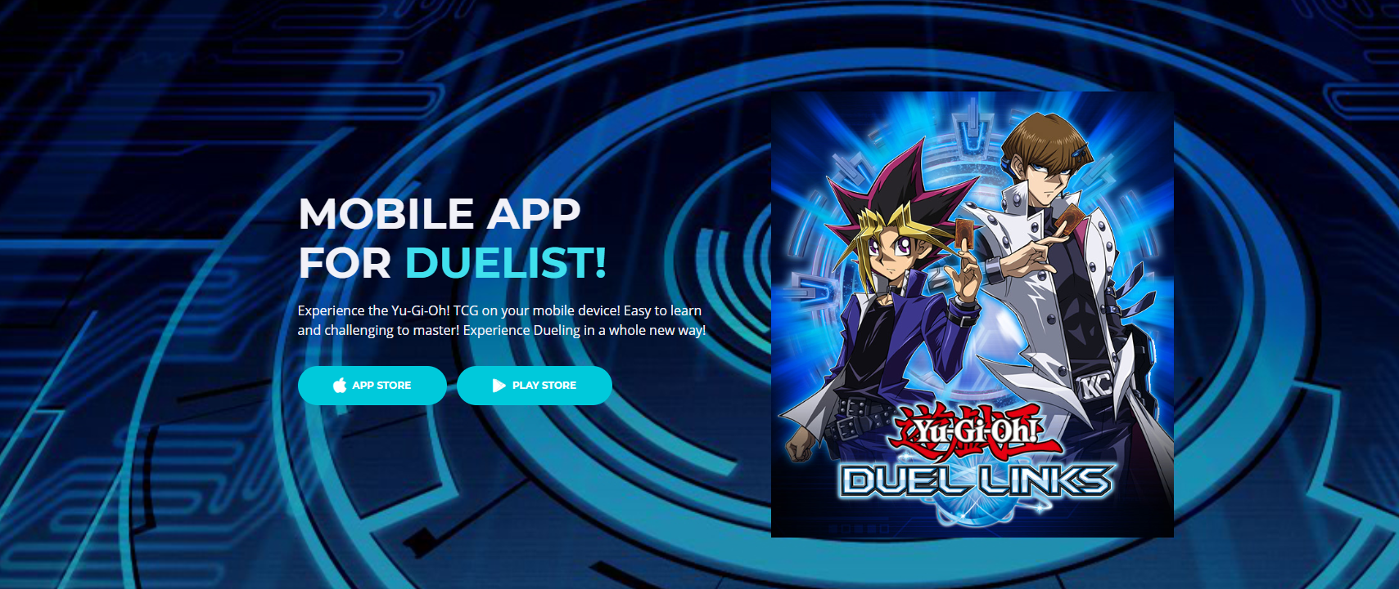
Landing Page

Slide 5
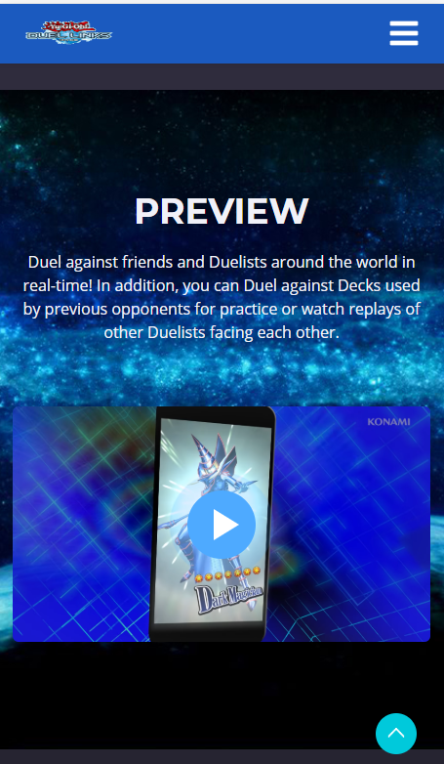
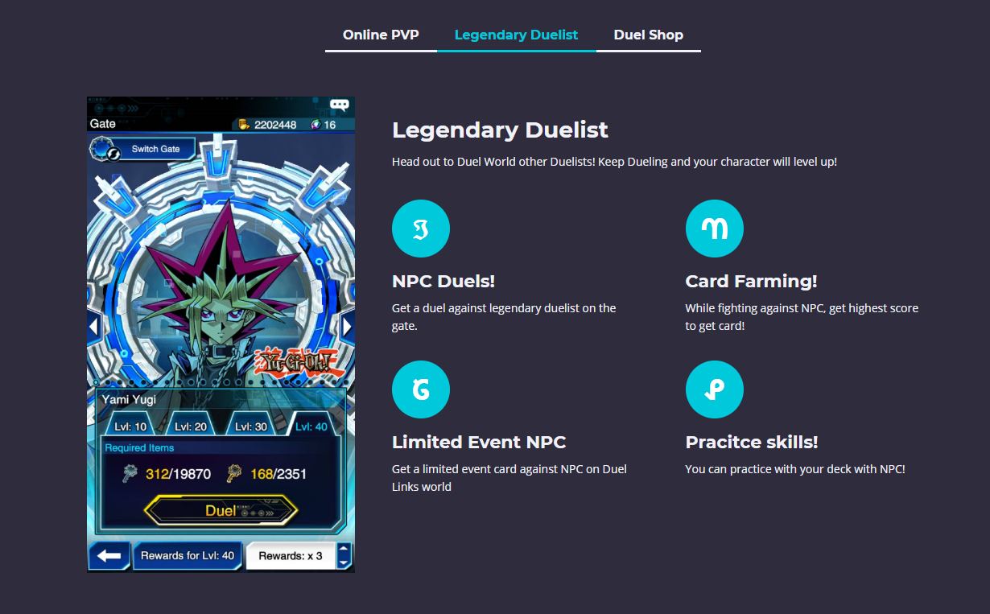
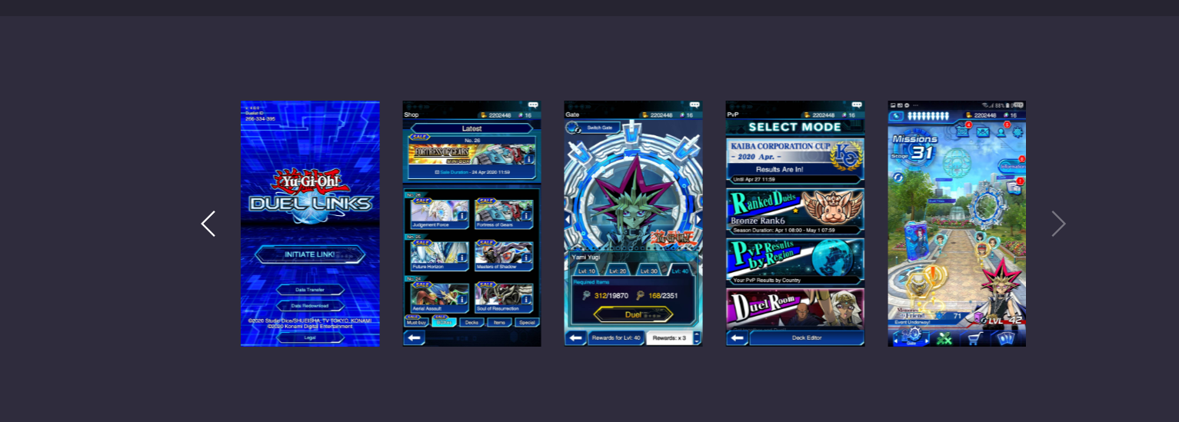
Display

Slide 6
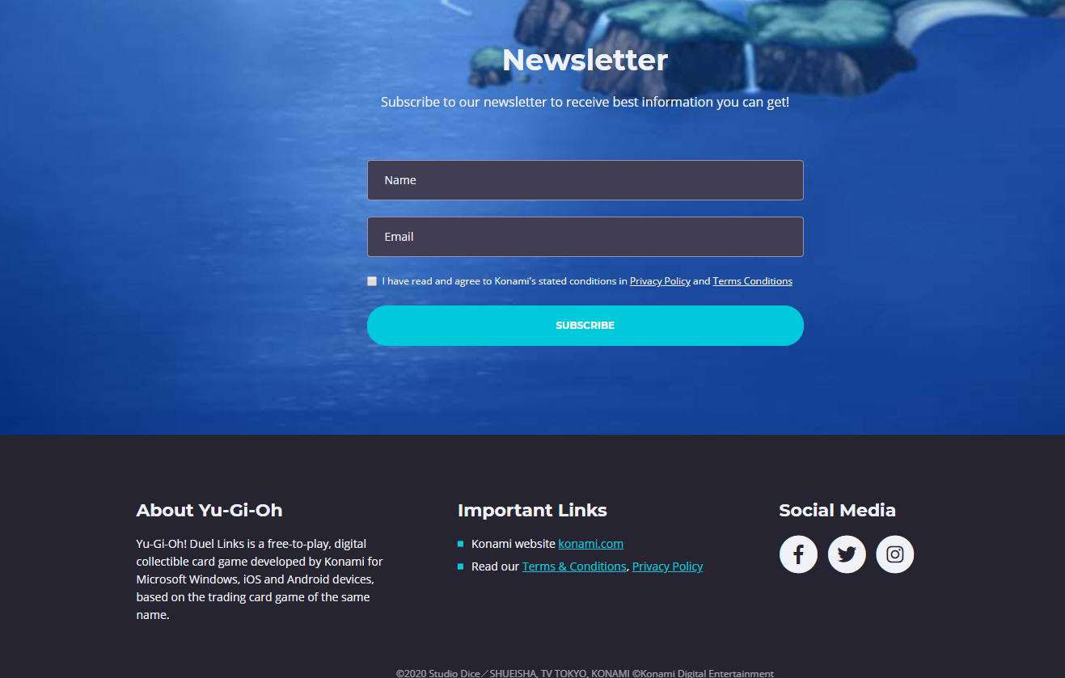
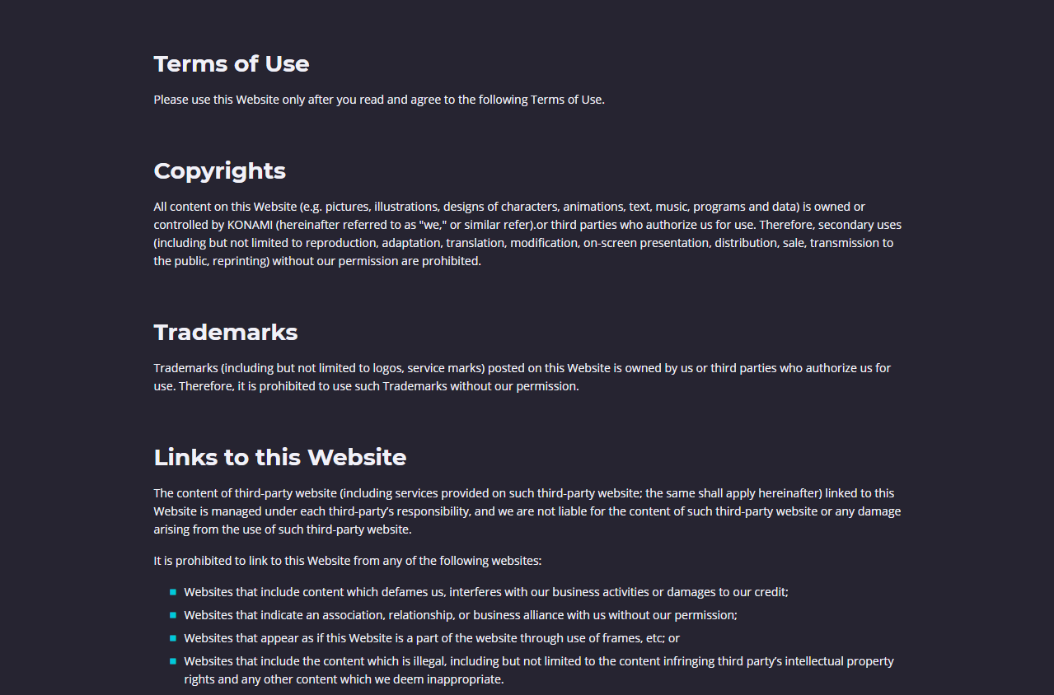
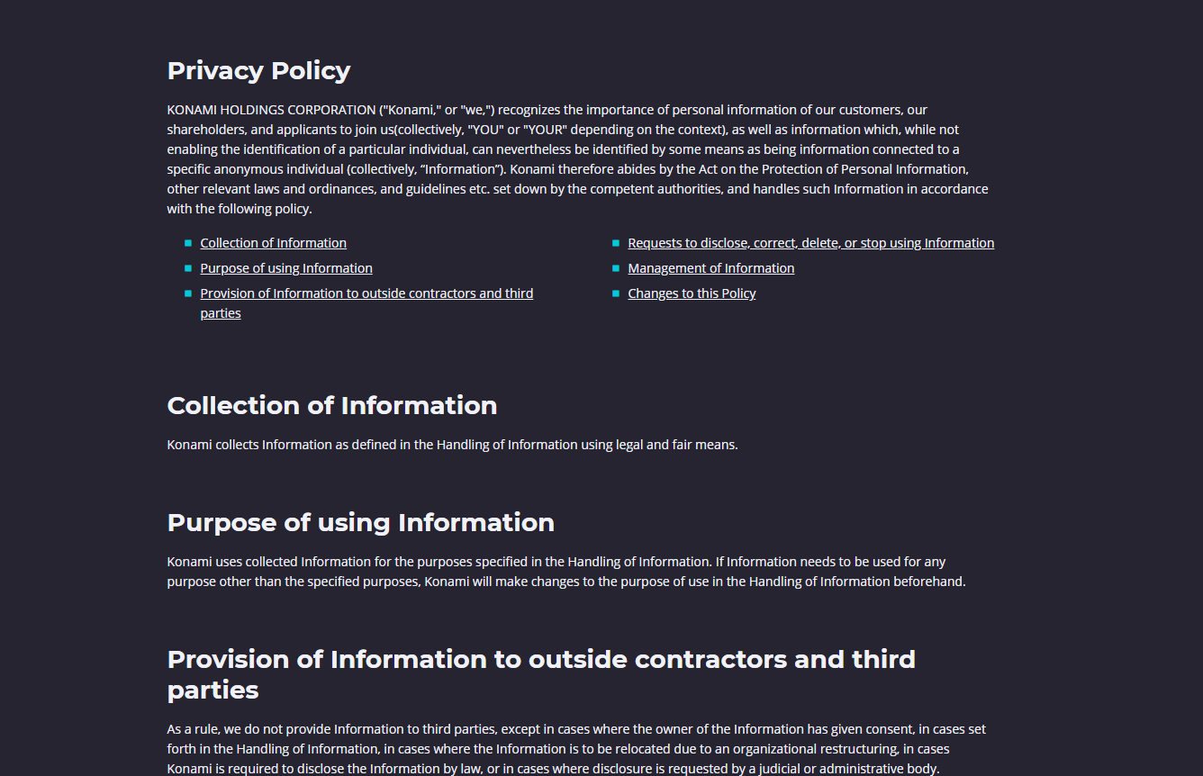
Display

Slide 7
Thank you!

